Slide 1
Acceleration of Statistical Detection of Zero-Day Malware in the Memory Dump Using CUDA-Enabled GPU Hardware
Igor Korkin, Ph.D. Iwan Nesterow Independent Researchers 2016
Notes:
Hi everyone! I’m Igor. Thanks for coming. This is the topic of my annual presentation.
The title is rather long but actually it means just speedy detection of unknown malware using statistics.
Let’s start.

Slide 2
Agenda
Motivation
Analysis of drawbacks of drivers detection
HighStem prototype
Drivers detection in the memory by separating code from data
GPU & CPU powered dump analysis
Notes:
You know, nowadays the vast majority of cyber-attackers are using various malware drivers to infect systems and it is very important to reveal kernel-mode infections. Today, I will outline the existing ways of drivers detection and how they can be bypassed. I’ll present the idea of “Highest Stealth Malware” or “HighStem”, which includes common anti‑forensic techniques and their future improvements. Then, I’ll give you some ideas how to detect suspicious drivers under these difficult conditions. And finally, I’ll show you how to speed up the analysis of memory dump.

Slide 3
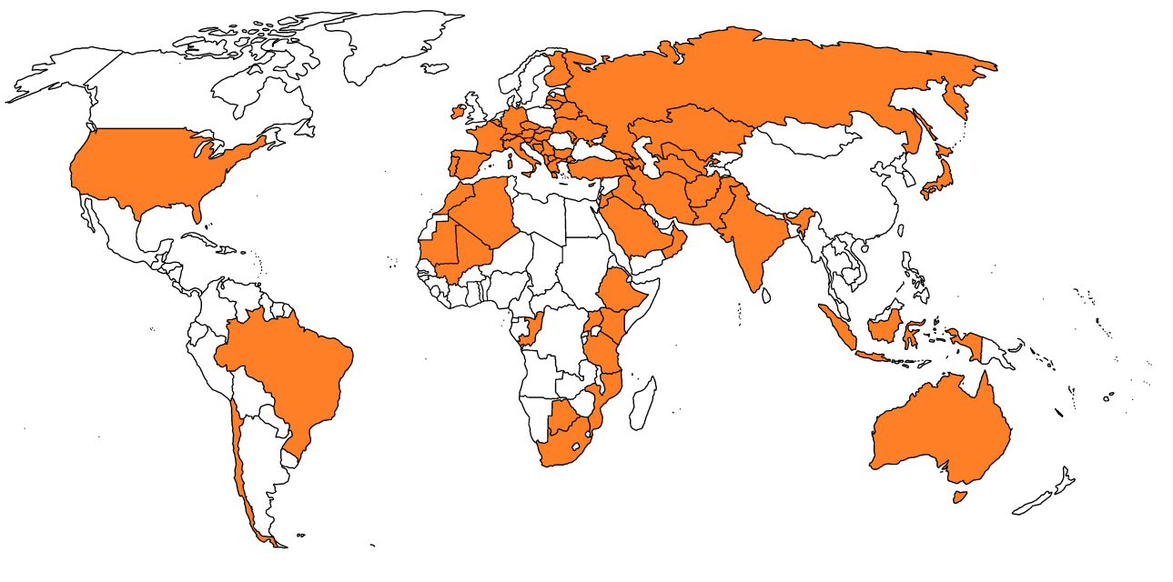





5-year cyber espionage attack
69 countries were attacked
Sensitive data were collected from hundreds of victims
*https://securelist.com/blog/incidents/57647/the-red-october-campaign/
Notes:
During last 5 years various companies from 69 countries were severely attacked by sophisticated malware. The attackers collected information from hundreds of high-profile victims from government agencies and embassies, institutions involved in nuclear and energy research, oil, gas and even aerospace industries. The most awful thing is that nó-one was aware of the breach. I believe that it is possible to detect such malware attack much earlier and these are my findings. First of all, let’s look at the modern malware, which is usually well-targeted and well-prepared.

Slide 4




Modern malware in modern world
Well-targeted | Well-prepared
 | Uses 0-day exploits Contains fake digital certificates Applies anti-forensics tricks
BlackEnergy trojan
Havex malware
+20% rise of incidents
Detection becomes too time-consuming
Notes:
You know, for example, ‘BlackEnergy’ trojan infiltrated into the power grid and water distribution systems. Another example is ‘Havex’ malware, which caused significant damage to a steel mill plant in Germany two years ago. You know even in the US now there is about 20% increase in computer security incidents in the nuclear power stations. The most dramatic thing is that hackers can plant malware, which can be simultaneously executed to disrupt various systems and cause cascading failures.
By and large such malware code is always well-prepared to its detection. The point is that hackers know very well how anti-viruses work and they apply various anti-forensic techniques to avoid malware detection. Nowadays we need to detect hidden malware, under these new conditions, under the deliberate countermeasures. These three aspects of malware, are indicative of a higher level of adversary’s involvement.

Slide 5
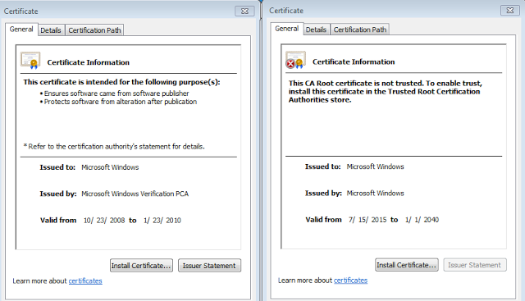
BlackEnergy used fake digital certificates (on the right hand side) and also notice how the expiration date of the certificate is set to 2040
Certificate from the legal file
Certificate from the BlackEnergy trojan
http://malware-unplugged.blogspot.ru/2016/02/blackout-memory-analysis-of-blackenergy.html
Notes:
For example, malicious binaries can contain fake digital certificates even from Microsoft, so this kind of ‘authentication process’ becomes absolutely senseless. You can see that malware authors are clever enough to be one step ahead. We can say modern antiviruses have no ability to react swiftly against highly sophisticated malware attacks. Let’s look inside the modern malware and see what’s what.

Slide 6
Inside modern malware & its detection
Notes:
Malware usually includes an exploit, a dropper and a malware driver itself. The exploit is aware of vulnerabilities and gains control of a computer system. The dropper installs driver in the operating system. After that the malware driver is loaded and the system becomes infected. After-a-while, anti-virus companies create new signatures or new updates. And only after the installation of these updates the malware will be deleted and finally our computers will be okay again. But, during this infection phase, users do not know that their computers are infected. And, no‑one‑knows what to do until antivirus guys prepare their reports. Revealing of modern malware is very time-consuming. You see, sometimes it can take even several months.
Look at the slide, the blue curve shows the malware “life cycle”. Hackers always improve their ‘products’.
My idea is to warn users about the suspicious driver as early as possible. Here! Look at the yellow arrow.
This early notification of a suspicious driver can help users to prevent losing data, which is the most important thing. And, it could initiate the ‘incident response’ much earlier.

Slide 7
Cross-view drivers detection
Match the contents of two lists of drivers:
# | Drivers list made by | Example of the lists content | Vulnerable
1 | A built-in tool, e.g. ZwQuerySystemInformation |  | yes
2 | An expert |  | Hope not
A
B
C
, ,
1
2
3
4
, , ,
How to get
the 2nd list of drivers?
Warn about a suspicious driver
Notes:
To clarify the problem with drivers-detection let me tell you about a cross-view-detection-approach.
This well-known approach is based on comparing two lists of drivers information. These lists have to be based on two different sources of drivers data. An anomaly could be found by periodically comparing the content of these two lists. The first list is usually filled-in by the Windows built-in tool. A malware driver usually bypasses this list, because otherwise it can be easily detected by any user. We usually assume that hackers don’t know about all other lists, but actually clever hackers succeed in bypassing all the lists. So this is the main question – how to fill-in this hypothetical second list, which will be resilient to common anti-forensic techniques?

Slide 8
Using updates in the memory content as a source for drivers detection
Original memory | After a new ‘driver C’ is loaded
Driver A
Driver B
Driver A
Driver B
Driver C
Two updates:
new structures
new file driver
Ways to detect:
links
signatures
statistics
Notes:
To answer this tough question let’s look at what has been changed or added in the operating system, after some new driver is loaded. The information about it is automatically added into several system lists and its file is loaded from the hard disk into the memory. As a result, we’ve got new structures in the lists and new file in the memory. Both of these changes can be used to create various lists of drivers.

Slide 9
Classification of drivers detection
The ways to detect drivers
Using drivers structures
Using the content of the drivers files
Notes:
According to these changes all detection approaches can be classified into two groups: using drivers structures and using driver’s files in the memory.

Slide 10
Classification of drivers detection
The ways to detect drivers
Using drivers structures
Using the content of the drivers files
Based on the links between structures
Signature-based scanning of drivers structures
Notes:
Structures can be detected using links and by signature based scanning.

Slide 11
Classification of drivers detection
The ways to detect drivers
Using drivers structures
Using the content of the drivers files
Based on the links between structures
Signature-based detection
Signature-based scanning of drivers structures
Statistical-based detection
Notes:
Files can be revealed also by using signature-based approach and a statistical-based approach. For me the statistical-based detection is the most perspective way. But, now let’s start with the lists based on the links between structures.

Slide 12
Detect drivers using drivers lists
Drivers list names | Name of structure
PsLoadedModuleList | KLDR_DATA_TABLE_ENTRY
ObjectDirectory | DRIVER_OBJECT
Service record list by SCM | SERVICE_RECORD
Threads from ‘System’ | ETHREAD
Recently unloaded drivers | UNLOADED_DRIVERS
Get a drivers list using links | Overcome detection by unlinking
Notes:
Here you can see a set of popular lists and corresponding structures, which store drivers information. Various detection functions acquire information about drivers by walking through different lists, but their structures are very similar. Each driver has its own structure, which contains information-about-it, such as the name of the driver, its size etc. All structures are linked in the list. This is a common way to store data in computers. Here you can see an example of memory content with three linked structures. I’ve marked the links between structures by the following numbers – 50, 80 and 10. The Windows function gets the list of drivers by walking through these numbers. It’s just an example. But a malware driver can bypass its detection by unlinking its structure from the list. Unlinking means just modifying pointer values between neighboring structures, it is the typical operation in the lists. This unlinking attack yields two results. The built-in tool and other links-based tools are not able to find this driver; and this unlinking doesn’t cause the reboot, its hidden for common user.

Slide 13
Apply byte-to-byte scanning using structures signatures to detect drivers
Type of structures signature | Examples of signatures and structures
Pool-tag by ExAllocatePoolWithTag | KLDR_DATA_TABLE_ENTRY DRIVER_OBJECT SERVICE_RECORD
Bytes fragments (fields-based signatures)
“MmLd”
“Driv”
“sErv”
* ADFSL’14
Get a list using structs signatures | Overwrite fields to hide structure
Notes:
But, if a structure is-hidden-just by using unlinking it can be revealed. Drivers structures have typical fragments or signatures, which are the same for all structures from one list. We can reveal all structures by using byte-to-byte signature scanning and it’s not important whether they are linked or unlinked. There are two types of signatures, based on the pool-tag and based on the typical bytes fragments. The pool-tag includes 4 bytes and is added to the structure automatically by the OS, using this Windows function. Look! Here are the examples of pool-tag signatures, and they are quite readable. Apart from the pool-tag, signatures can be based on the fact that some bytes in all structures are the same. These fields-based signatures include only the bytes, whose values are the same for all structures, which are in one list. Here are the examples of these kind of signatures. But a malware driver can bypass all these signatures by partially overwriting the content of the unlinked structure. And as a result signature based scanning is not able to recognize or detect the modified structure. Thus, simultaneously applying unlinking attack and overwriting makes drivers’ structures absolutely useless for creating that second list of drivers.

Slide 14
What do we still have in the memory?
Driver A
Driver B
Hidden Driver C
Header
Import Address table
Code section (executable)
Header
Import Address table
Code section (executable)
Header
Import Address table
Code section (executable)
How to find PE-files in the memory?
Notes:
So what can we use instead? What do we still have in the memory? Neither structures nor links. But we still have the drivers files loaded in the memory and we can find them. All drivers files like Portable Executable or PE-files include typical fragments. Using byte-to-byte signature scanning we can reveal all drivers files. We can use the following parts of PE-file for detection: the file header, the import table and the code section.

Slide 15
Apply byte-to-byte scanning using features of PE-file to detect drivers
Driver as a PE-file includes: | PE-file features |  | Countermeasures
 | Type of signature | Examples
 | ASCII Strings | ‘MZ’ , ‘PE’ , ‘This program cannot be run in DOS mode’ | Data overwriting
 | ASCII Strings | ‘ZwOpenFile’
 | Bytes combination (prologue & epilogue) | 8BFF MOV EDI,EDI 55 PUSH EBP 8BEC MOV EBP,ESP 8BE5 MOV ESP,EBP 5D POP EBP C20400 RET 4 | Code obfuscating & packing
Header
Import Address table
Code section
(executable)
Notes:
The first signature is based on ASCII strings, which are located in the file header and the import table. The most famous ASCII strings are "MZ" “PE” and “This program cannot be run in DOS mode”. Also, by searching names of Windows functions we can reveal the import table and then the whole driver file in the memory. And the last one is based on the fact that drivers files include a code section. This code has got fixed byte fragments, for example, the beginning of function – prologue and ending of function – epilogue. Here is an example of byte patterns for prologue and epilogue. But, after a driver has been loaded, it can overwrite the ASCII fragments and also use obfuscation technique to bypass the bytes signature.

Slide 16
What do we still have in the memory?
Driver A
Driver B
Hidden Driver C
Header
Import Address table
Code section (executable)
Header
Import Address table
Code section (executable)
Header
Import Address table
Code section (executable)
How to find code sections?
Notes:
Ok, What can we use instead? Look! What do we still have in the memory? No structures, no links, no signatures in PE-file. But we still have the executable code in the memory, because malware needs to be executed. If we are able to distinguish the executable code from other memory fragments it will really help us. So, the challenge of completing the second drivers list comes down to the recognition task between the executable code and other data fragments in the memory.

Slide 17
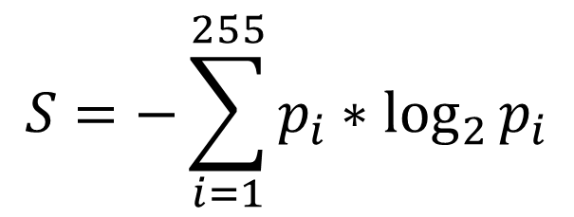
Using binary Entropy to separate data types
$$S=−\sum_{i=1}^{255}{p_{i}∗\log_{2}{p_{i}}}$$
Definition:
$$p_{i}−the frequency of each byte value in the file.$$
Entropy
*Using Entropy Analysis to Find Encrypted and Packed Malware by R. Lyda & J. Hamrock
Notes:
To solve this task, we will operate with statistics or secondary values, which are calculated from the memory content. The best-known statistic to evaluate memory content is the binary entropy, which can be calculated in the following way. Apart from binary entropy, which uses only one byte, we can also calculate entropy using two bytes or bigram analysis, as well as using three bytes or trigrams. You know that by comparing entropy values we can distinguish different data types, like a plain text, encrypted data and native executables. Higher entropy values can indicate the encrypted fragments or the executable fragments. Lower entropy corresponds to data structures. Entropy is usually calculated for the whole file to check if this file is packed or protected. Also by using byte-to-byte or a sliding-window approach we can locate the encrypted fragments and the executable exploits in various sources, like PDF-files.

Slide 18
Using sliding-window approach to locate executable code
E.g.
Window size is 256 byte
Overlap is 256 byte
Executable code with high entropy
Entropy values
Offsets
Notes:
We can apply this idea for analysis of memory dump. We can calculate entropy values in a sliding window using various windows size and their overlapping and can obtain a regional information density as a function of the byte offset. This is an example of such a function for memory dump fragment. We can see that the executable fragments have high entropy values. Using this distinguished feature we can easily separate an executable code from other memory fragments.

Slide 19
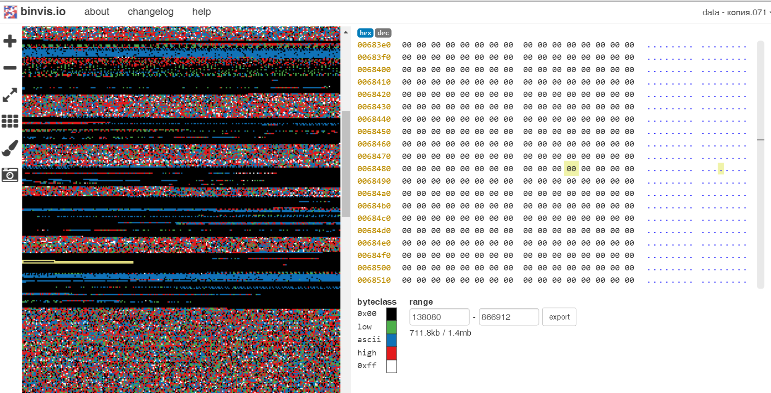
Colored diagram of memory dump via binvis
Notes:
Another idea of data visualizing is coloring each byte in the dump files according to its hexadecimal value. Here is an example of visualization of a memory dump fragment using the online service binvis.io. We can easily locate null pages in the memory and distinguish particular sections of drivers files. Black blocks are corresponding to null pages. The blue values are corresponding to ASCII fragments. Solid multicolored blocks are corresponding to the executable code, which we are looking for.

Slide 20
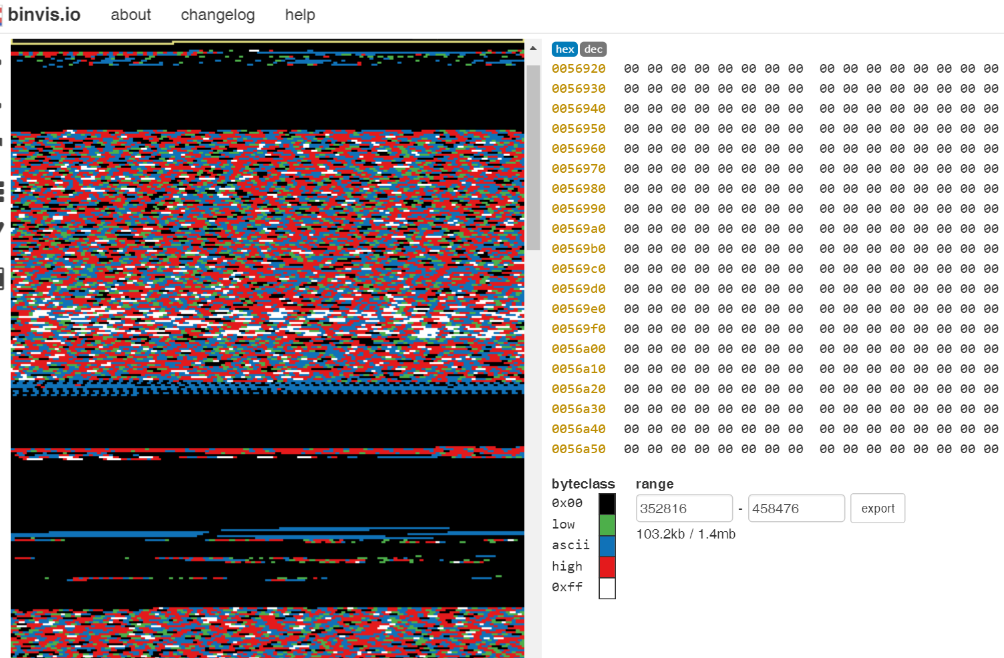
2x zooming
Notes:
Let’s zoom-in to specify the analysis of the memory region.
Now we can easily distinguish various sections of PE-file.

Slide 21
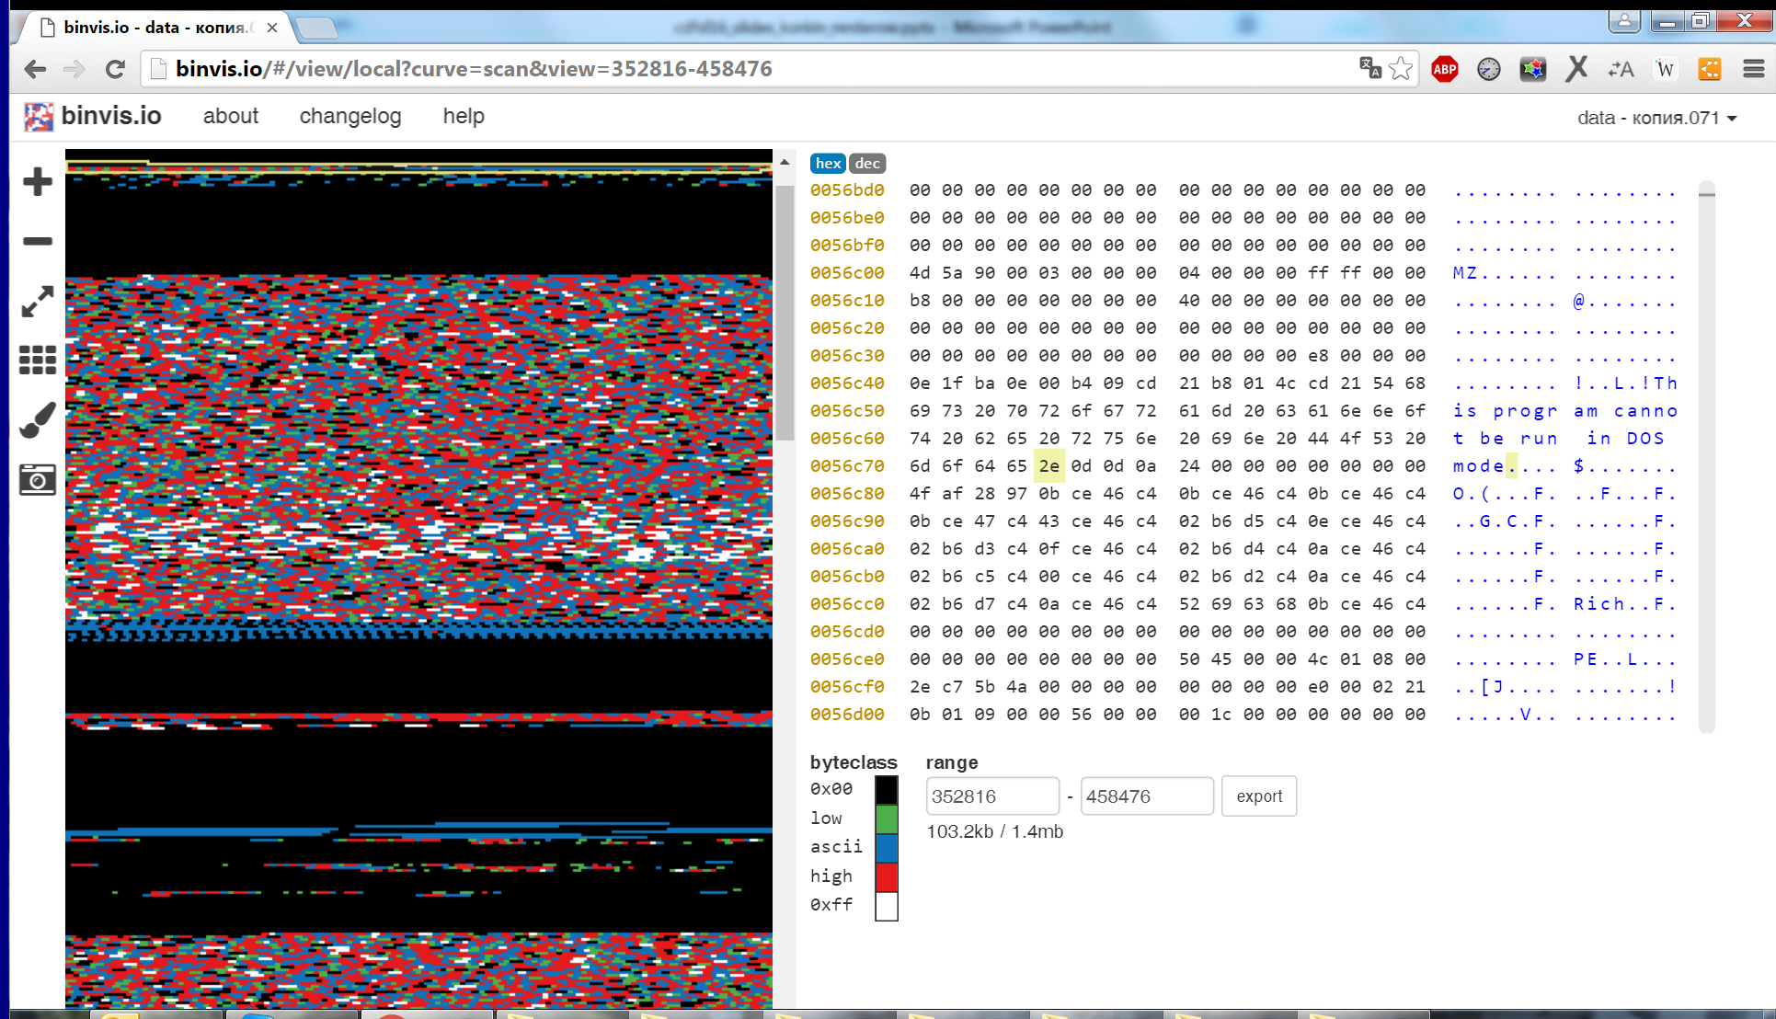
PE header of the driver file
Notes:
This is the beginning of PE-file with well-known ASCII signature.
Now we are scrolling down the dump file to cover all its important fragments.

Slide 22
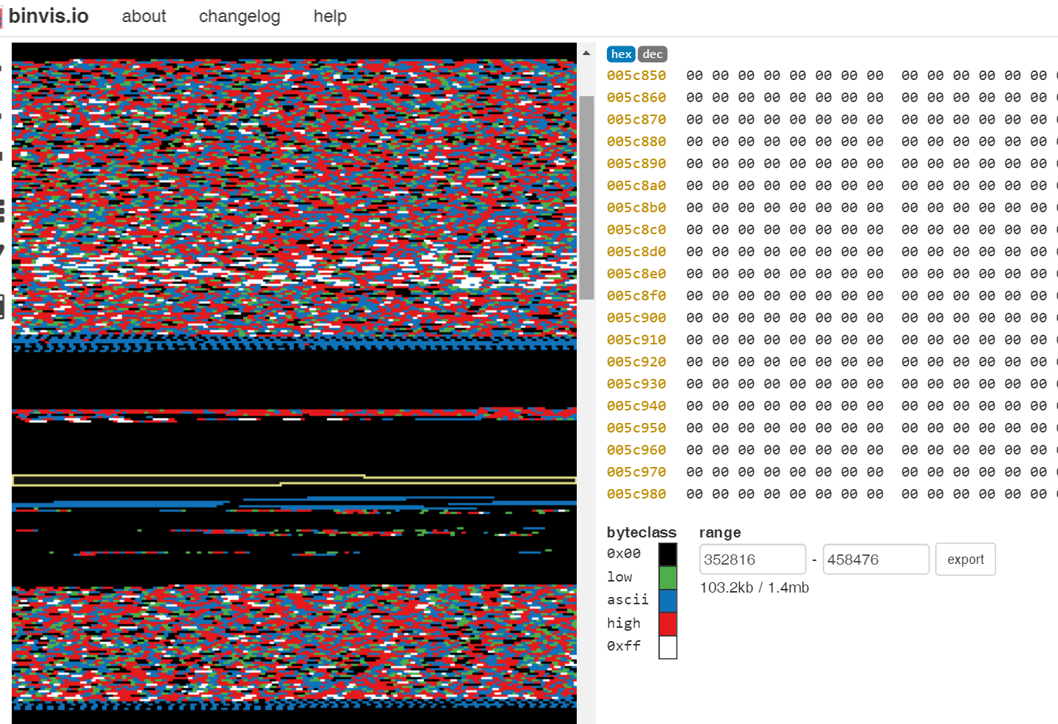
Move down
Notes:
This multicolored fragment is corresponding to the executable code and we need a disassembler to analyze its logic. Let’s scroll down.

Slide 23
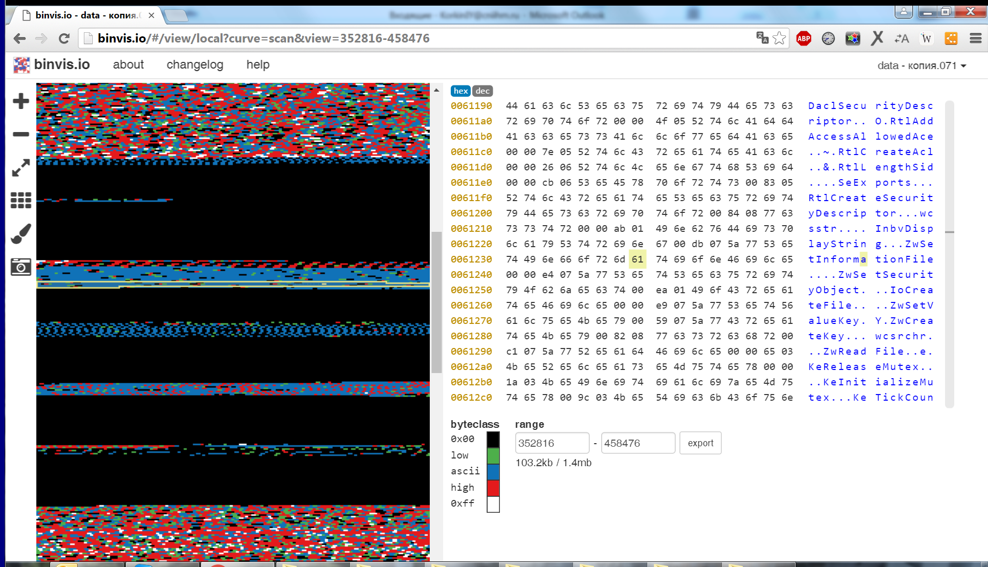
Import table includes functions names
Notes:
The section with blue blocks is corresponding to the import table. We can see the functions names here.
OK, you see that the analysis of entropy plots mentioned before and data visualization can really help to reveal executable code fragments. But, these statistical methods are also vulnerable to malware countermeasures. If malware driver is able to decrease its high entropy values it becomes hidden again.

Slide 24
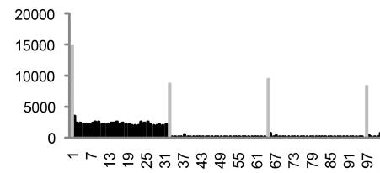
An idea to overcome entropy analysis & its vulnerability
Overcome entropy analysis
Its vulnerability
Original code
with high entropy
Insert blocks to decrease entropy
Zeus Trojan
97 97 97 97 97
67 67 67 67 67
31 31 31 31 31
blocks with zero entropy
Locate data blocks
using byte histogram:
It is also susceptible!
Notes:
As a result, we will see in colored diagram more black blocks. The executable code which we are looking for becomes diluted. The authors of Zeus Trojan already proposed this idea of code dilution. The technique includes inserting blocks of symbols with zero entropy into the code. As a result, the code section of driver is distributed through the memory. It helps to evade entropy analysis. Fortunately, or unfortunately, this hacker’s technique is also vulnerable and can be detected. The thing is that the Zeus Trojan inserts blocks with the same length and the same content. Cyber-security experts proposed an idea of extracting and deleting such data blocks. This became possible by applying byte histograms to analyze the memory content. Look at these red ovals. On the diagram these columns are corresponding to the inserted blocks of symbols, which decreased the entropy. We can easily extract these blocks and calculate the entropy without them. But, applying this byte histogram is also vulnerable. I’ll show you the appropriate anti-forensic technique a bit later.

Slide 25
All detection methods are vulnerable
The ways to detect drivers |  | Anti-forensic technique
Using drivers structures | Using links between structures | Unlinking
 | Signature-based scanning | Overwriting
Using content of drivers files | Signature-based scanning | Overwriting & PE packing
 | Statistical-based detection | Inserting data blocks
Let’s consider the most difficult case for detection - HighStem
Notes:
So, we can say that all analyzed detection methods are vulnerable. Any malware driver can be hidden by many ways but the results will always be the same – running an uncontrolled code in the privileged memory area and this code will have a low entropy value. Now let’s integrate all anti-forensic techniques and see how they are improving. The purpose is to imagine the most difficult scenario for detection

Slide 26
Highest Stealth Malware (HighStem) imitates the most difficult case for detection
Apply Atsiv or Turla Driver Loader to load a HighStem driver
Collect data without OS function:
Improve Zeus manipulation:
Read keystrokes from the memory
kbdhid.sys → DEVICE_EXTENSION →KEYBOARD_ATTRIBUTES
Insert data blocks with low entropy
A
B
C
Blocks
with zero entropy
or/and
A
Spread code fragments
B
C
...
Notes:
In a nutshell the Highest Stealth Malware – HighStem is just the kernel-mode driver. The main idea of the HighStem functionality is using as few Windows functions as possible and acquire information straight from the memory. For example, we can get keystrokes just by reading specific memory regions, without using any Windows functions or installing a filter driver. My preliminary research reveals that the codes of keystrokes are included in the structure keyboard attributes, which could be located in this way.
Also, I’ve got some ideas of how to improve Zeus trojan’s manipulations to hide its code from the Δ byte histograms analysis. The first thing is to insert blocks of symbols, with low but not zero entropy value. The second idea is to insert different size blocks. And also we can significantly increase the size Δ and the number of these data blocks. As a result, it will look like using camouflage for executable code. Next I’ll present some ideas how to locate such a super hidden code. I’ll mark the memory fragments with this code as a suspicious one, without deciding if this code is a real malware or not.

Slide 27
How to reveal all parts of diluted executable?
Calculate entropy using smaller window size
A
A
B
B
C
...
C
...
Notes:
The task to detect a malware driver comes down to the recognition task between the executable code and other memory fragments. But in our situation this task is hindered by the code dilution. The obvious thing is to apply existing a sliding window approach using smaller window size. This helps us to find separate pieces of executable code but unfortunately it will probably cause a lot of false positives.

Slide 28
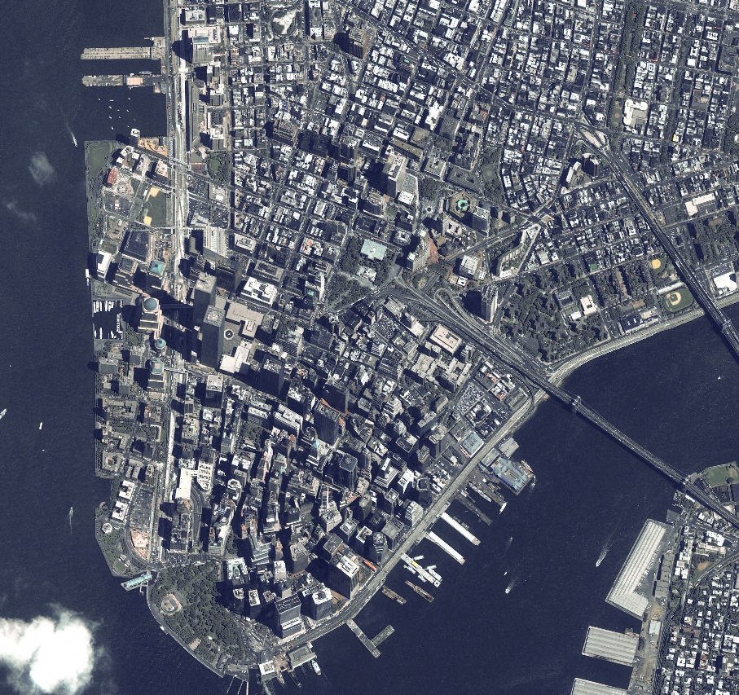

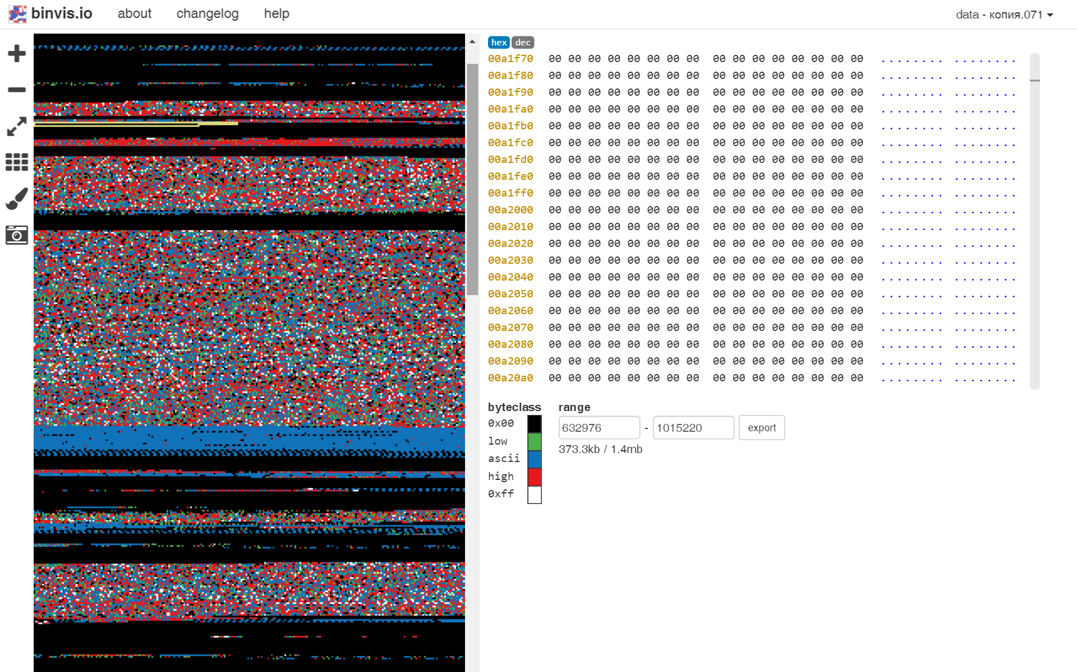
Apply digital photogrammetry to locate a code
*Lower Manhattan, November of 2000 by AirPhotoUSA
CODE
CODE
IMPORT
CODE
HEADER
Notes:
A bit crazy idea is to use best practices from different technical fields, for example, digital photogrammetry. The methods of digital image recognition can distinguish faces in the iPhones, recognize houses and roads in the map using various approaches, such as artificial neural networks. And why not apply this for drivers detection? In our case we need to distinguish anomalies in entropy figures or find executable fragments in colored diagrams.

Slide 29
Analyze the disassembly code
push %ebp
mov %esp,%ebp
push %ecx
sub $0x4,%esp
movl $0x80484b0,(%esp)
call 80482f4
mov $0x0,%eax
A
1
B
2
2
1
Apply Zipf-Mandelbrot law
C
2
...
3
4
3
A
B
C
Notes:
Apart from this, we can locate the executable code using a disassembler for each code fragment and analyze the output in different ways. For example, we can do it by drawing a control flow graph and analyze the logic for each fragment. The purpose is to find the links between various fragments, and put together all three blocks A-B-C. Another idea is to apply a linguistic law to decide if this assembler code belongs to the executable or it is just data. This Zipf-Mandelbrot Law is not so trivial and I’d like to tell you more about it.

Slide 30
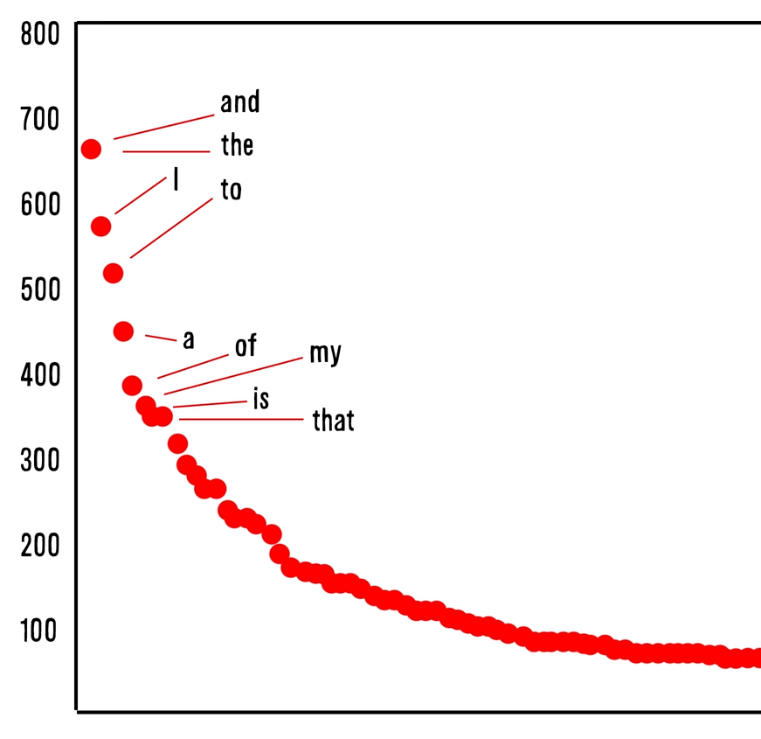
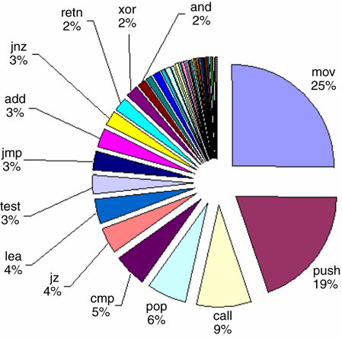
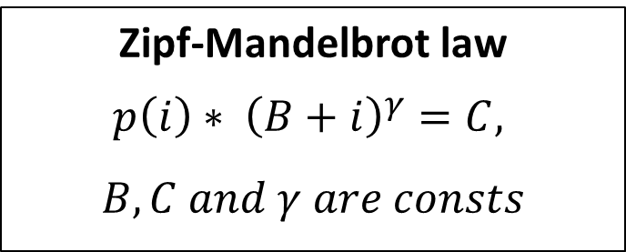
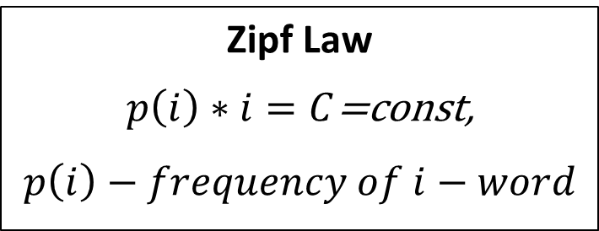
Zipf-Mandelbrot law From linguistics to disassembly listings
# of occurrences
Word rank
Zipf Law
$p\left(i\right)∗i=C$=const,
$p\left(i\right)−frequency of i−word$
Zipf-Mandelbrot law
$$p\left(i\right)∗ {\left(B+i\right)}^{γ}=C, \\ B, C and γ are consts$$
*Zipf, Human behavior and the principle of least efforts
Mandelbrot, An information theory of the statistical
structure of languages
Notes:
The American linguist George Zipf found that the frequency of words is inversely proportional to their rank in frequency lists. For example, if we rank all words in Romeo and Juliet we will see the following hyperbolic curve. The most frequent words such as “the” and “and” are on the top, while rare words are in the right tail. This law works well in all existing languages. This is the law of how languages work. The mathematician Benoit Mandelbrot expanded this law by adding two more constants. And his law works well on texts with high logic. The point is the opcodes of executable codes have similar frequency ranks stability. The most popular opcode is “MOV”, next is “PUSH” “CALL” and their ranks are so close to human language. My idea is to check opcodes ranks for each fragment – if these ranks are close to Zipf-Mandelbrot principle.

Slide 31

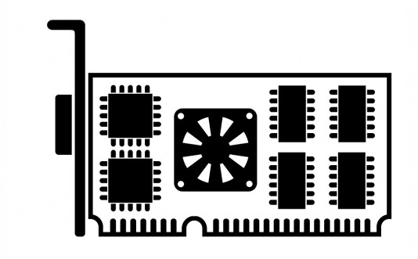
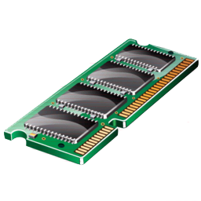
Graphics card - a powerful computing unit in a PC
Graphics card with its own processors & memory
16 GB/s
PCI-e Bus
16 GB/s
16 GB/s
CPU & RAM:
32 cores on CPU
16 GB/s bus speed
8-16 GB of RAM
~0,6 Teraflops
Graphics card:
1536 cores on GPU
130 GB/s bus speed
4 GB of RAM
>1 Teraflops
*Intel i7-6785R, launch date Q2'16
*GeForce GTX 980M
Notes:
All ideas mentioned before require a lot of computational power and we have hardware, which has feasible capabilities. Let’s look at the modern graphics card. GPU has more than one and a half hundred cores, while modern CPU has only thirty cores. GPU bus speed is about 10 times higher than the bus between CPU and RAM memory. Why don’t we use GPU for processing a sliding windows algorithm?

Slide 32


Porting issues of common sliding-window algorithm to GPU
We tested drivers detector from the paper ‘Applying memory forensics to rootkit detection’ ADFSL’2014, Richmond, VA
GPU works efficiently on 128-byte size coalesced memory
GPU operates much slower on distinct memory fragments
Sliding-window algorithm
(on DRIVER_OBJECT structure,
164 byte block)
Local data processing with coalesced memory accesses
Processing of data, which is located out the window block (e.g. dereferencing pointers)
Notes:
We tested drivers detector from paper ‘Applying memory forensics to rootkit detection’, which uses a sliding window type algorithm to detect hidden drivers structures. This algorithm includes two distinctive features. The first part corresponds to processing the data locally inside the window block. GPU shows up the best performance on such operations. The second part is processing the memory fragments outside the window block. Unfortunately, GPU has rather low speed in such out of block operations. So, the best performance occurs when memory accesses can be coalesced into consecutive byte chunks.

Slide 33
Hybrid GPU & CPU architecture for common sliding-window algorithm processing
Decomposition task
GPU
CPU & RAM
Local block processing
Shared memory with preliminary results
Out of the block processing
1
Dump file
2
3
4
Dump file
Aggregation task
Notes:
Taking these two features into account, we can split the sliding window algorithm in GPU and CPU parts, which can run concurrently. Graphics video card computes its part of analysis and sets the score of each memory region into the table with preliminary results. CPU uses this table and handles only the memory regions with appropriate metrics. Thus the GPU part performs only local memory block analysis, transferring further processing to CPU. Operating system API functions calls are also processed by CPU, eg iswprint.

Slide 34
Speeding up memory forensics by CUDA-enabled GPU hardware
only CPU, Intel i7-4870HQ
Duration, sec
GPU & CPU GeForce GTX 980M
Dump size, Mb
Notes:
Here is the final current speed up achievements. We have the 2-3 times speeding up. Now we are working to process large dumps on GPU.
This demonstrates the benefits of applying GPU for memory forensics and incidents response tasks.

Slide 35

Conclusions
Prototype of the most hidden code – a HighStem
Ideas to locate executable code
Using CUDA to speed up memory dump analysis
Notes:
In a nutshell in this talk I’ve presented how to detect the most dangerous memory parts or an executable code. I presented the analysis of drivers detection ways and their drawbacks. I focused on HighStem driver, which includes evasion mechanisms and new ideas to overcome entropy analysis. The presented detection ideas will be able to reveal any diluted executable code. Finally, I demonstrated the architecture of a software tool, which uses video cards to speed up memory forensics. This work is now still in progress. And now I’m looking for a team who will consider this as a prospective direction. So, I’ve got some more ideas how to detect zero-day malware.

Slide 36
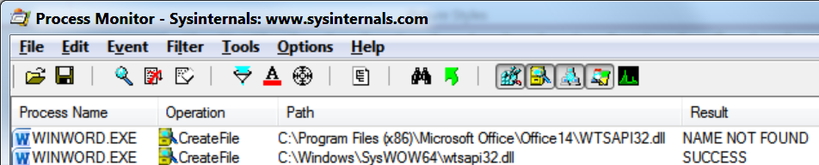
#1: MemoryMon monitors memory changes to track programs activities in real time
MemoryMon
Notes:
One of my dreams is to track memory changes or programs activities in the memory in real time. We have similar tools to monitor file system, registry and network activity, but we don’t have such a tool for memory. It will be so helpful for cyber security. My idea is to create a memory monitor or MemoryMon which will be hidden for malware, speedy in operation and resilient to common anti-forensics techniques. To do this I worked out in collaboration with a researcher from Canada, his name is Satoshi, and we developed a thin hypervisor using Intel VTX and EPT technologies.

Slide 37
#1: MemoryMon monitors memory changes to track programs activities in real time
MemoryMon scenarios:
Details:
Monitoring & controlling kernel-mode events by HyperPlatform
by Satoshi Tanda @standa_t and Igor Korkin, REcon 2016.
Notes:
MemoryMon can be used to monitor memory in two cases. The first one is monitoring access to specified memory regions to protect system critical data. We will log and control all access attempts to this memory region. The second case is recording any types of memory access from a specified memory region. We will monitor memory activities of a suspicious driver. All details about implementation are in Satoshi’s talk on the REcon conference.

Slide 38

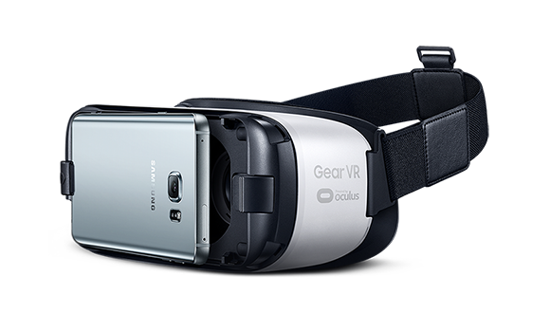

#2: Apply virtual reality headset for digital forensics investigations
by Samsung
by Oculus
‘It's like watching a 130-inch television screen from 10 feet away’*
http://www.pocket-lint.com/news/134352-vuzix-iwear-720-a-vr-headset-that-s-like-putting-a-130-inch-tv-in-front-of-your-face
Notes:
During an incident response process cyber security experts analyze huge amount of data, such as different systems logs and memory dumps. To do all these things, why don’t we use virtual gears or headsets, which are so popular nowadays. New 3D view, instead of existing 2D, could really speed-up analysis and could make it more vivid. I hope it will become one of the future trends in cyber security.

Slide 39
Thank you!
igor.korkin@gmail.com
Notes:
Thank you!

Slide 40
Темы УИРов и дипломов
Обнаружение уязвимостей программного обеспечения в условиях отсутствия их исходного текста
Обнаружение скрытого программного обеспечения в мобильных операционных системах
Создание облачного антируткита и антивируса
Исследование перспективных технологий с позиции внедрения вредоносного ПО
Исследование средств удалённого контроля работы компьютерных систем
Применение технологии аппаратной виртуализации в задачах защиты информации
Подробнее - https://sites.google.com/site/igorkorkin/for-students

Slide 41

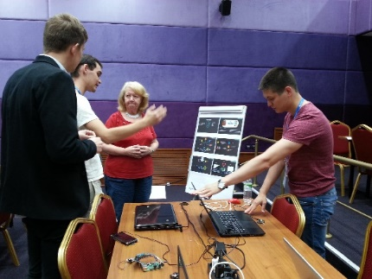
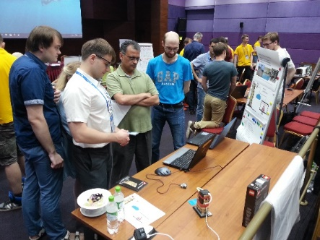
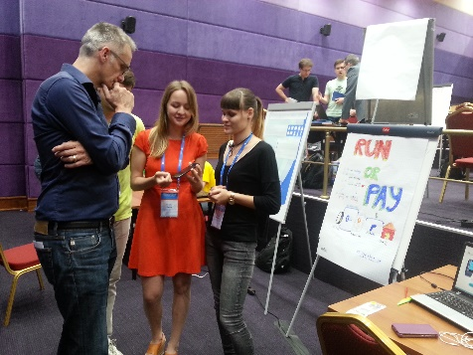
Чем ещё заниматься?
Летние школы Майкрософт, Intel, ШАД:
Выставки и конференции
Стажировки – http://www.fulbright.ru/ru
Изучением английского языка - http://amc.ru/

